Slide 2

Epion Computer Solutions
Epion is a leading provider of comprehensive computer solutions for businesses of all sizes.
Epion Computer Solutions is a private limited company incorporated on January 2012
Epion's services include HRM and payroll software, search engine optimization, and inventory/stock management systems - all designed to streamline operations and drive growth.

Slide 3

Product and Service
Enterprise Software Solutions: Epion offers a suite of customizable and scalable software solutions to meet the unique needs of businesses across various industries.
Human Resoruce(HRM) and pyroll software
Online Promotion: Epion's team of expert technicians provides comprehensive maintenance, support, and optimization services to ensure the smooth operation of client's IT systems.
Search Engine Optimizations
Inventory/Stock System

Slide 4
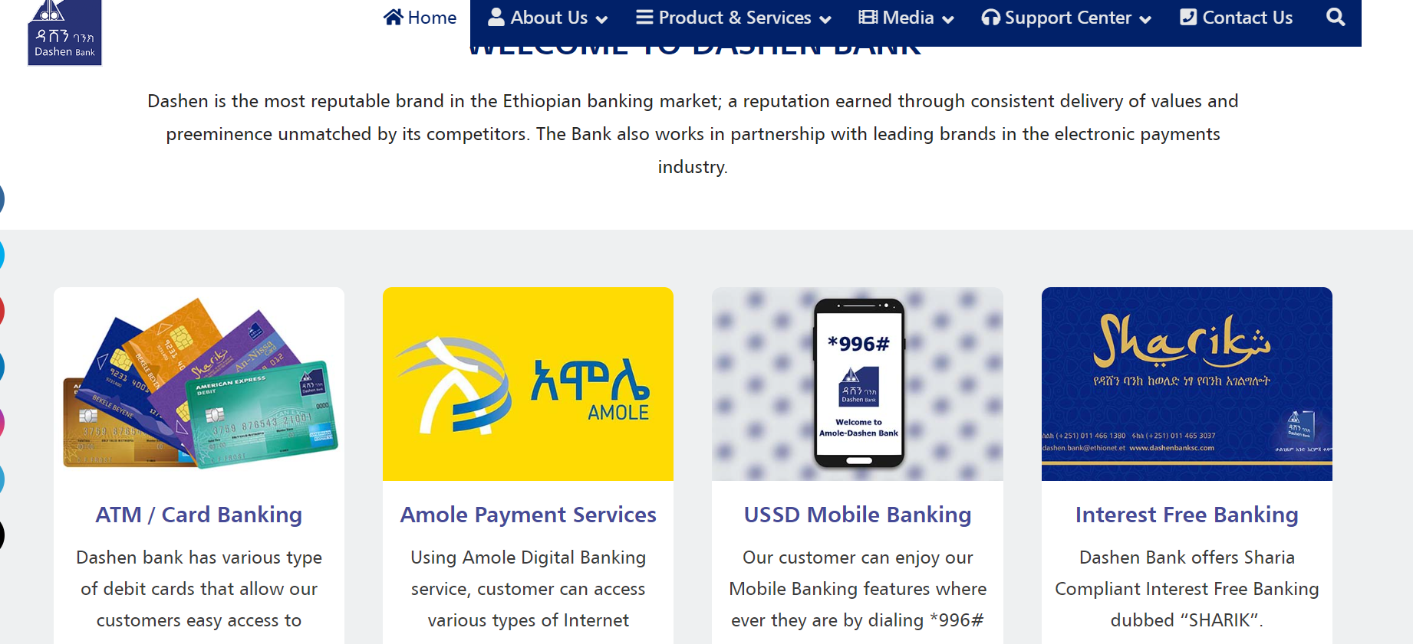
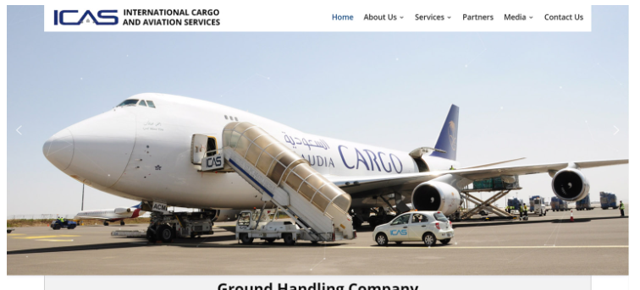
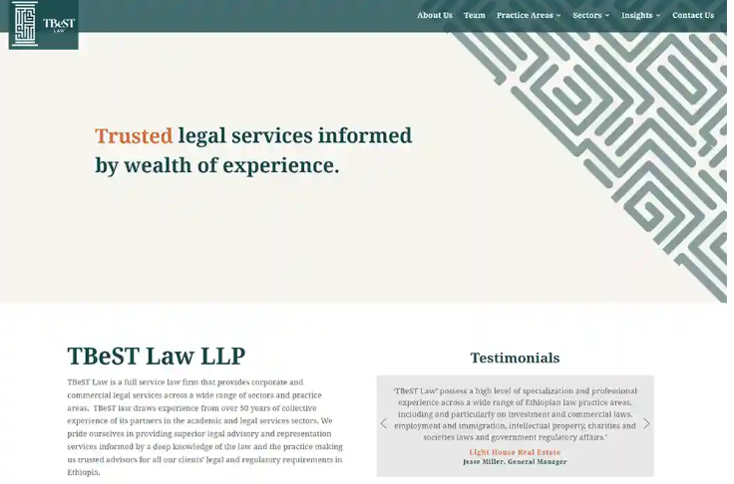
Main Projects Made by Epion
Dashn Bank
ICAS
TBeST
Our company designed a corporate website for Dashen Bank s.c, one of the leading Banks in Ethiopia.
Our company designed the corporate website for International Cargo and Aviation Services (ICAS).
Our company developed a website for TBeST Law LLP, a full service law firm that provides corporate and commercial legal services

Slide 5
Chapter Two: The Internship
1
Responsibilities and Duties
2
Hands-on Learning
I developed a mobile application called "Addis Biz Business Directory" that boasts a comprehensive directory of over 20,000 local businesses in Addis Ababa, empowering users
Gained practical experience in programming languages, database management, and project management tools used by the Epion team. Attended training sessions to expand my technical skillset.
3
Collaborative Environment
4
Real-world Exposure
Worked closely with experienced developers and project managers, learning from their expertise. Contributed ideas and solutions in team brainstorming sessions.
Participated in client meetings, providing support and gaining insights into the challenges and requirements of Epion's diverse customer base.

Slide 6


Technical Skill
Key Flutter Development Skills:
Cross-platform mobile app development
Dart programming language proficiency
Responsive UI design using Flutter's widget-based architecture
Integration with backend services and APIs
Implementing features like push notifications and geolocatio\n

Slide 7
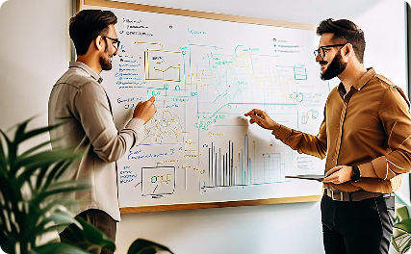


How Does Real life Application Developed
Design Phase
Development Phase
Testing and QA
The design phase involves gathering requirements, creating wireframes, and defining the technical architecture to ensure the software meets the client's needs.
During the development phase, the engineering team implements the designed features using agile methodologies, leveraging the latest technologies and best practices.
Extensive testing and quality assurance measures are undertaken to identify and resolve any issues, ensuring the delivered software is robust and reliable.

Slide 8



Realstic Expectation
Challenging Enviroments
1
Transportation
Teamwork
2
Ups and down in team work
Client Interaction
3
Client Requirement
During my internship at Epion, I gained invaluable real-world experience by working on challenging s,enviroments collaborating with talented team members, and directly interacting with clients. These hands-on opportunities allowed me to develop a deeper understanding of the application development lifecycle and the importance of effective communication and problem-solving skills.

Slide 9



Teamwork
Senior Dev
Communication
Accountability
Work closely with team members to combine unique skills and perspectives, fostering creative problem-solving.
Establish clear and open communication channels to ensure everyone is aligned and working towards shared goals.
Take ownership of your responsibilities and deliverables, while supporting your teammates to do the same.

Slide 10
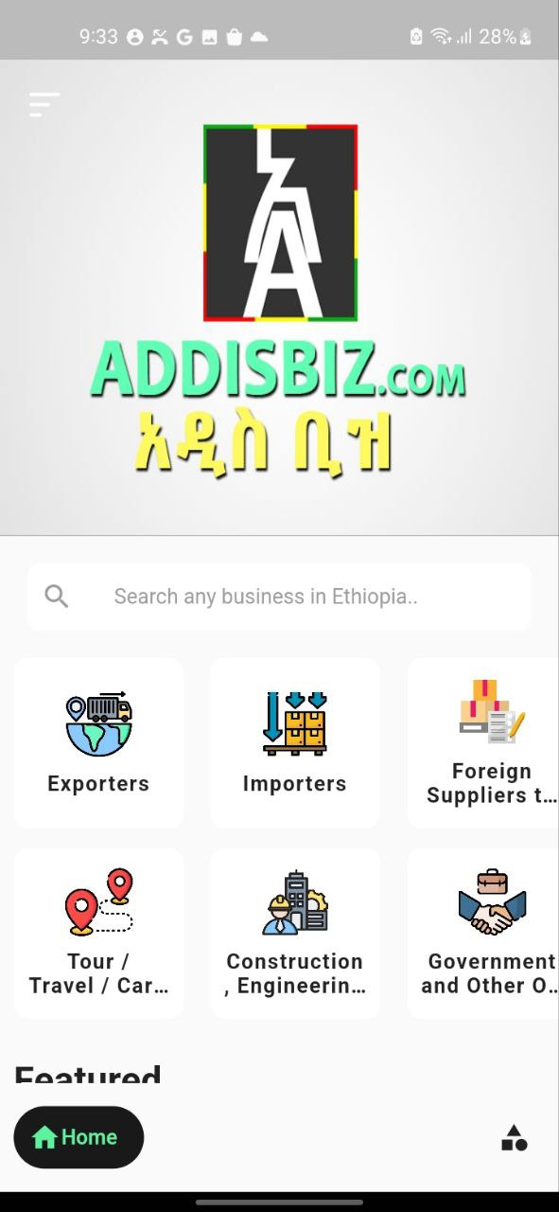
Chapter Three
AddisBiz Business Directory
A cross platform Mobile applicaAddis Biz is a comprehensive Ethiopian business directory, boasting over 20,000 detailed listings of local companies. This one-stop shop allows you to easily find the products and services you need, connecting you with a vast network of Ethiopian businesses.

Slide 11
The Need For The Project
Centralization
Modern UI
Accountability
Work closely with team members to combine unique skills and perspectives, fostering creative problem-solving.
Establish clear and open communication channels to ensure everyone is aligned and working towards shared goals.
Take ownership of your responsibilities and deliverables, while supporting your teammates to do the same.

Slide 12
Overview of the AddisBiz Business Directory App
Comprehensive Business Directory
1
The AddisBiz app provides users with a vast database of over 20,000 local businesses in Addis Ababa, Ethiopia, spanning various industries and sectors.
2
Classified
Busineses are classified in their category and subcategory. For example AES Trading plc Found. Export-Agriculture-AES Trading
SEARCH
3
Users can search the database by entering keywords or phrases, filtering results based on specific fields, and receiving a list of relevant entries,

Slide 13
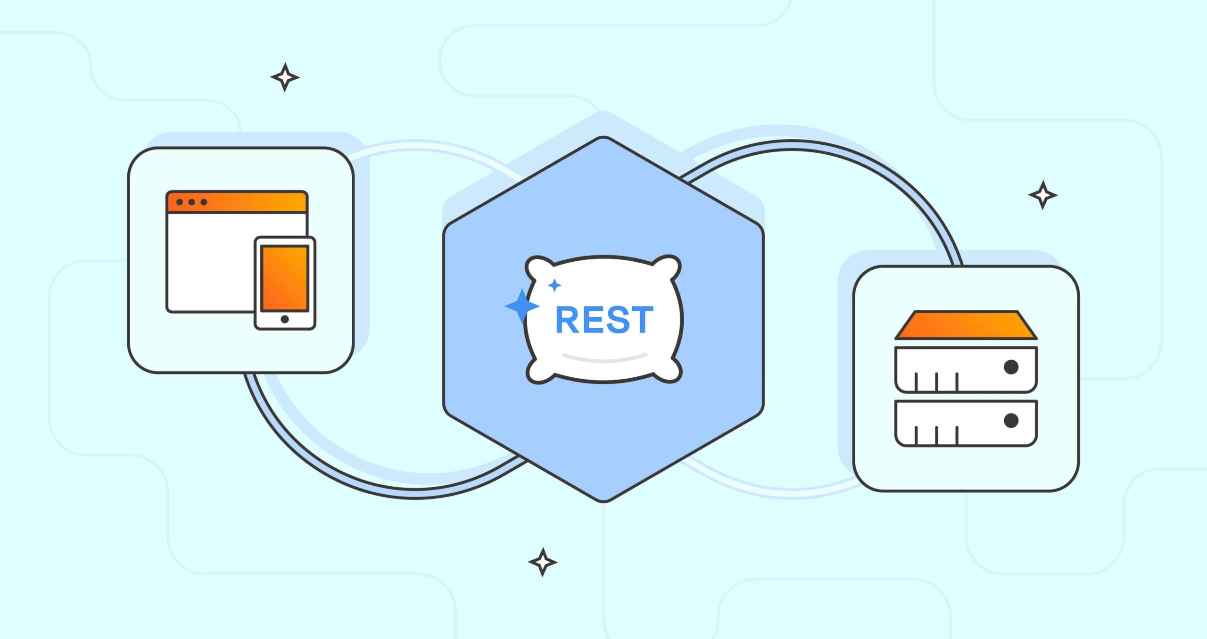

Tool Used
Flutter
REST API
Laravel
Proficiency in various programming languages, including JavaScript, Python, and SQL.
Effective communication and teamwork skills, working cross-functionally with diverse teams.
Analytical thinking and critical problem-solving abilities to address complex challenges.

Slide 14

Objectives of the Internship
1
Gain Practical Experience
2
Develop Technical Skills
3
Explore Career Opportunities
Translate classroom knowledge into real-world application by working on various projects and initiatives.
Enhance proficiency in programming languages, software development methodologies, and project management tools.
Discover potential areas of interest and gain insights into the dynamic technology industry.

Slide 15
Tool Used
Flutter
REST API
Laravel
Proficiency in various programming languages, including JavaScript, Python, and SQL.
Effective communication and teamwork skills, working cross-functionally with diverse teams.
Analytical thinking and critical problem-solving abilities to address complex challenges.

Slide 16




Challenges Faced and Lessons Learned
Adapting to New Environment
Learning New Tech
Transportation
I found it hard Learning new tech and working on project
Debuging pain
Embracing a growth mindset, being proactive in acquiring new skills and knowledge.
Navigating the corporate culture and learning to work effectively within a professional setting.

Slide 17
Achievements and Accomplishments
Successful Project Delivery
Positive Feedback
Contributed to the successful launch of a mobile application, meeting all project deadlines and requirements.
Received positive feedback from the team and management for my contributions and dedication.
Professional Growth
Networking Opportunities
Demonstrated a strong work ethic and a willingness to take on additional responsibilities.
Actively participated in team events and industry networking activities, expanding my professional connections.

Slide 18
Home Page
Epion is a leading provider of comprehensive computer solutions for businesses of all sizes.
Epion Computer Solutions is a private limited company incorporated on January 2012
Epion's services include HRM and payroll software, search engine optimization, and inventory/stock management systems - all designed to streamline operations and drive growth.

